Slide 1


K.RAMAKRISHNAN COLLEGE OF TECHNOLOGY
(AUTONOMOUS), TRICHY
ATTENDANCE MANAGEMENT SYSTEM
PRESENTED BY SUPERVISOR
NESHANTH M Mrs.K.Valli Priyadharshini M.E., (PhD),
2303811710421105 AP/CSE.

Slide 2
PRESENTATION OVERVIEW
Objective
Project Introduction
Problem Statement
Methodologies (Programming concepts relevant to problem statement)
Architecture of the proposed system
List of Modules
Merits
Results and Discussion
Queries

Slide 3
OBJECTIVE
In educational institutions, tracking student attendance is a critical task that ensures accountability and enhances the learning environment. A Student Attendance Management System (SAMS) offers an automated and efficient solution to manage and monitor attendance.

Slide 4
PROBLEM STATEMENT
In organizations, educational institutions, and businesses, tracking attendance manually is time-consuming, prone to errors, and lacks real-time accessibility. Traditional methods such as paper-based registers or spreadsheets often lead to inefficiencies, such as lost records, inaccuracies, and difficulty in generating reports. There is a need for an automated, reliable, and user-friendly system to manage attendance seamlessly..

Slide 5
PROJECT INTRODUCTION
In today's rapidly evolving educational landscape, the effective management of student attendance has become increasingly crucial. Traditional methods of tracking attendance, which often rely on manual entry and paper records, are not only time-consuming but also prone to errors. To address these challenges, the implementation of a Student Attendance Management System (SAMS) offers a modern and efficient solution.

Slide 6
METHODOLOGIES
Classes and Objects
A class is a blueprint or template for creating objects, defining the attributes and An object is instance of a class, representing a specific implementation of the defined blueprint.
Date and Time Handling
Data handling refers to the process of storing, retrieving, and managing data efficiently in an application..

Slide 7
METHODOLOGIES
Exception Handling
Exception handling is a mechanism for handling runtime errors in a program to ensure it runs smoothly and avoids unexpected crashes.Graphical
User Interface
A GUI is a visual interface for interacting with a software application using graphical elements like buttons, text fields, and menus, instead of text-based commands.

Slide 8
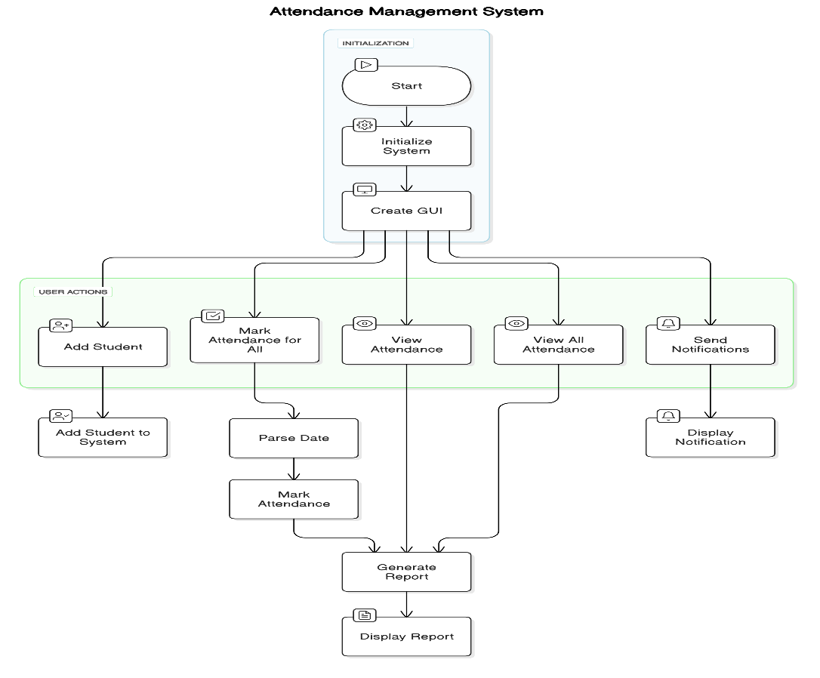
ARCHITECTURE OF THE PROPOSED SYSTEM

Slide 9
LIST OF MODULES
Main Program Module
Student Module
Attendance Record Module
Attendance Management System (AMS) Module
GUI Module

Slide 10
MERITS
Platform Independence Runs on any operating system with a JVM, ensuring compatibility.
Lightweight Framework Uses native OS components for faster rendering and better performance.
Simple API Easy to use for creating basic GUIs, ideal for small-scale applications.
Quick Development Rapid prototyping and implementation of user interfaces.
Event Handling Built-in event-handling mechanism for managing user interactions (e.g., button clicks).

Slide 11
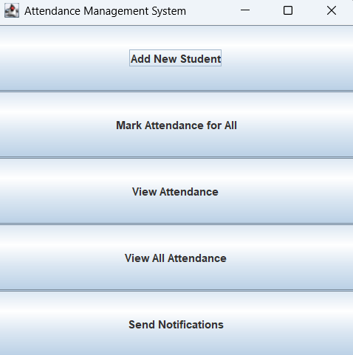
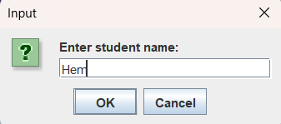
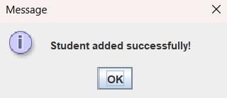
RESULTS AND DISCUSSION

Slide 12
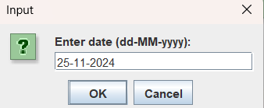
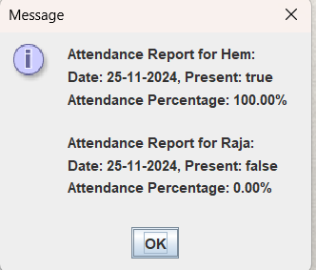
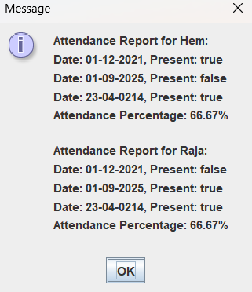
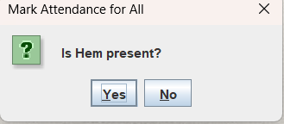
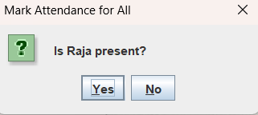
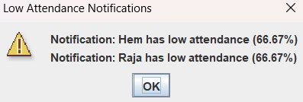
RESULTS AND DISCUSSION

Slide 13
QUERIES ?

